Slide 1
ENGR181W
How to Write a Manual
Some texts are directly from:
Wallwork, Adrian. User Guides, Manuals, and Technical Writing, A Guide to Professional English (New York: Springer Publications, 2014)
https://www.swipeguide.com/insights/how-to-write-manual-work-instructions
https://instrktiv.com/en/user-manual-template/
https://stepshot.net/how-to-create-a-user-instruction-manual/

Slide 2
Useful Resources:
https://dokit.io/10-golden-rules-to-help-you-create-a-great-user-manual/
https://www.wikihow.com/Create-a-User-Manual
https://blog.bit.ai/write-instruction-manual/
https://ucr.on.worldcat.org/oclc/881719875

Slide 3
■ A one-page assembly instructions sheet for a toy
■ An information booklet accompanying a sewing machine
■ A manual for a new car
■ A manual for some computer software
■ A sign in a laundromat showing how to use the machines
■ A note from one person (suddenly taken ill) to another, explaining how to perform a job role

Slide 4
■ All these documents are important:
if they are not written well, and something goes wrong because of ambiguous, confusing or incorrect text and visuals, then customers will sue.
Instructions and manuals:
■ Are often used in an unsystematic way
■ Are often misunderstood
■ Are often poorly written
■ Often go unread

Slide 5
Many people work on the assumption of ‘when all else fails, read the manual’.
Instead of the information document being the first resort for the user, too often it is the last resort.
Studies have found that users of software manuals tend to proceed in the following order when seeking information (Horton 1993; see also Jansen & Balijon 2002):
1. Try and see what happens (in other words, play around with it)
2. Ask another user
3. Call the vendor
4. Search online documentation (‘help’ screens within the software)
5. Read the manual.

Slide 6
Publishing phenomena of books aimed at ‘dummies,’ ‘complete idiots’ and ‘beginners.’
The more effective documents are, the more likely they will be read and used.
True effectiveness is a result of good:
Grammar,
Layout,
Style,
Editing, and
Analysis of the process or product being described

Slide 7
The Law
Products Liability says that a manufacturer has a legal duty to provide both warnings and instructions.
However, it distinguishes between instructions which are meant to “inform persons how to use and consume products safely” from warnings which “alert users and consumers to the existence and nature of product risks so that they can prevent harm either by appropriate conduct during use or consumption or by choosing not to use or consume.”

Slide 8
CATEGORIES
Bicycle Accidents(1)
Birth Injuries(9)
Brain Injury(7)
Burn Injuries(1)
Bus Accidents(4)
Car Accidents(41)
Dangerous Products(5)
Discrimination(8)
Dog Bites(3)
Employee Misclassification(1)
Factoid Friday(1)
Fire Injury(2)
Medical Malpractice(7)
Motorcycle Accidents(2)
Neck Injury(1)
News(20)
Nursing Home Abuse(1)
Pedestrian Accidents(4)
Personal Injury(52)
Premises Liability(4)
Product Liability(10)
Safety Tips(10)
Self-Driving(2)
Skiing Accidents(1)
Spinal Injury(2)
Train Accidents(1)
Truck Accidents(15)
Wage and Hour Claims(3)
Whistleblower(3)
Wrongful Death(3)
Wrongful Termination(2

Slide 9
PRODUCT LIABILITY: NEGLIGENCE
• Product Liability: A manufacturer’s, seller’s, or lessor’s liability to consumers, users, and by-standers (privity of contract is NOT required, which means the parties did not have to have a business deal or relationship directly between themselves) for physical harm or property damage that is caused by the goods.
Negligence: A manufacturer is liable for its failure to exercise due care to ANY person who sustained an injury proximately caused by the manufacturer’s negligence with regard to any of the following:
• design of the product,
• selection of materials (including any component products purchased from another seller that are incorporated into a finished product),
• use of appropriate production processes,
• assembly and testing of the product, and
• placement of adequate warnings on the product which inform the user of dangers of which an ordinary person might not be aware.

Slide 10
■ Two types of manuals
■ Manuals written for the general public
for example, a manual accompanying a new washing machine
■ Manuals written for a narrower group
for example, a service manual for a washing machine service person, a procedures manual for employees of a particular organization.

Slide 11
User Manuals/Instructions:
Study:
The subject of the user manual
The target audience.
These two go hand in hand.
By studying the subject with great attention to details, you can design how to write for the target audience.

Slide 12
You have to know the level of knowledge of your target audience on the subject in question.
In creating documentation for professionals, you need to go in depth.
For novice users, make sure to cover all the key moments and leave out more complicated unnecessary stuff

Slide 13
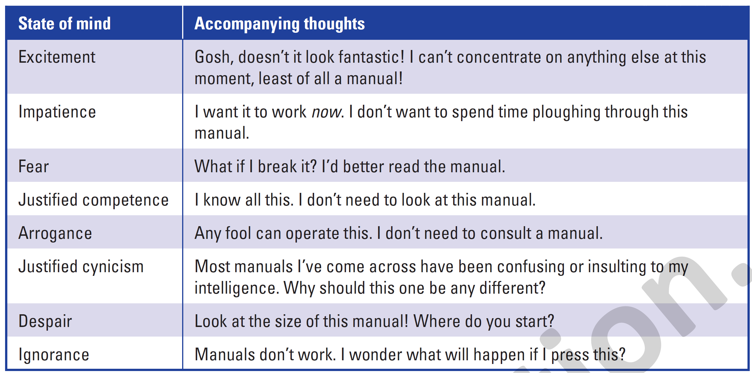

Slide 14
Users are reading to do rather than reading to learn.
Not infrequently, users are in a state of crisis — something has gone wrong, and they need answers fast: ‘Quick, where’s the manual?’
They therefore need a document that:
■ can be physically handled with ease
■ is physically robust
■ is user friendly

Slide 15
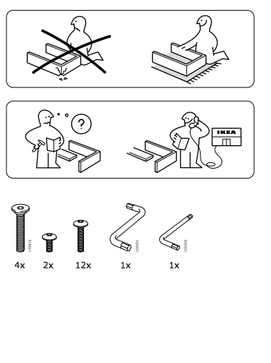

IKEA
The IKEA technical writers have basically created their own language to communicate with people of any race and almost any age.
This is a great example of working with the target audience.

Slide 17
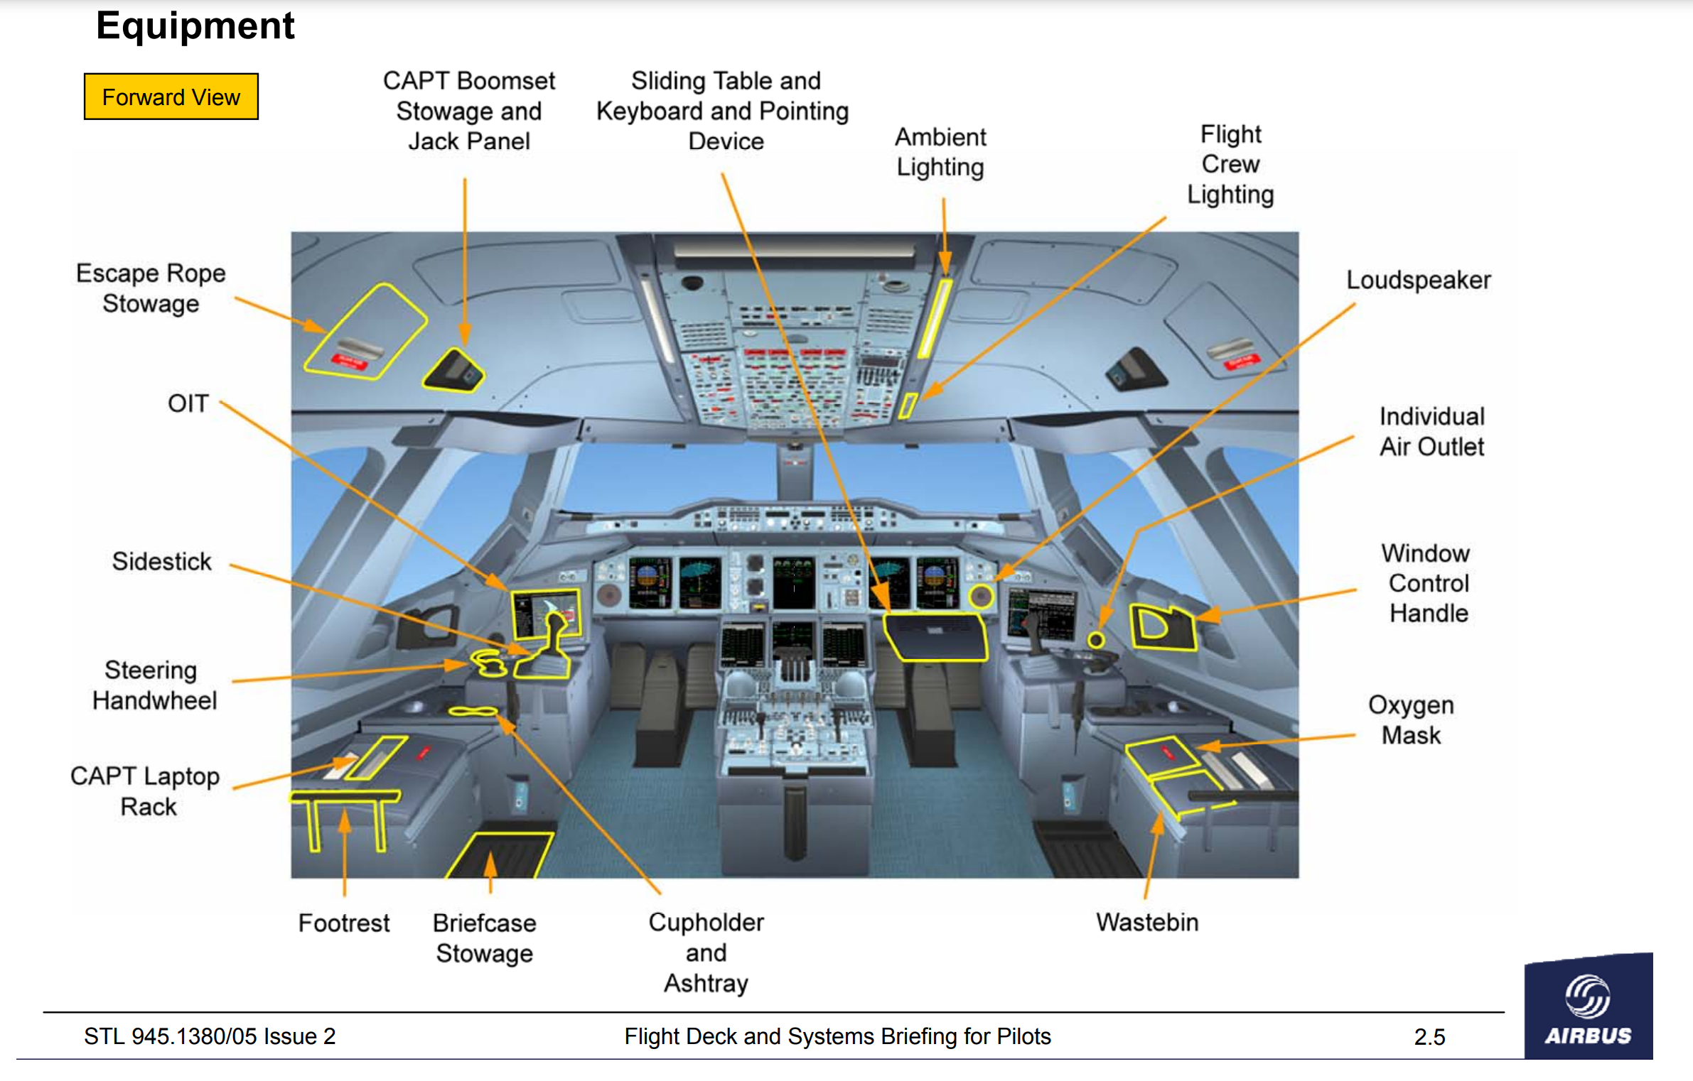
A380 Flight Deck

Slide 18
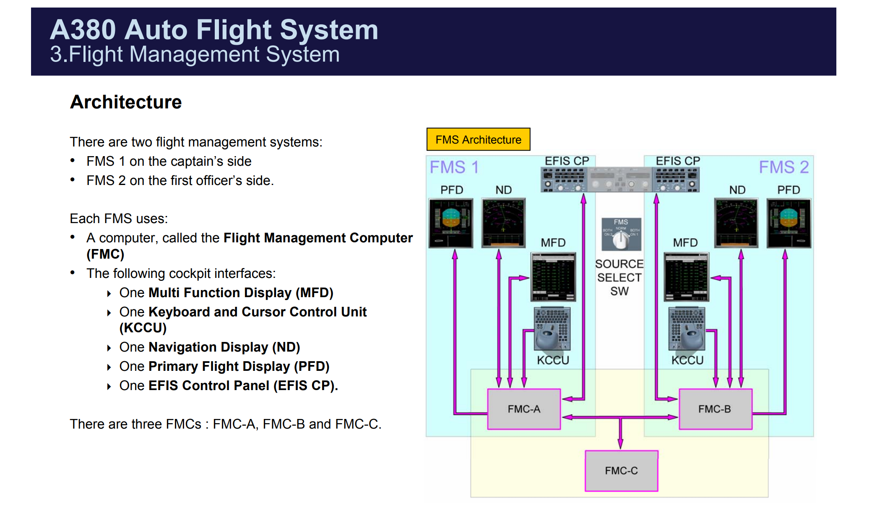

Slide 19
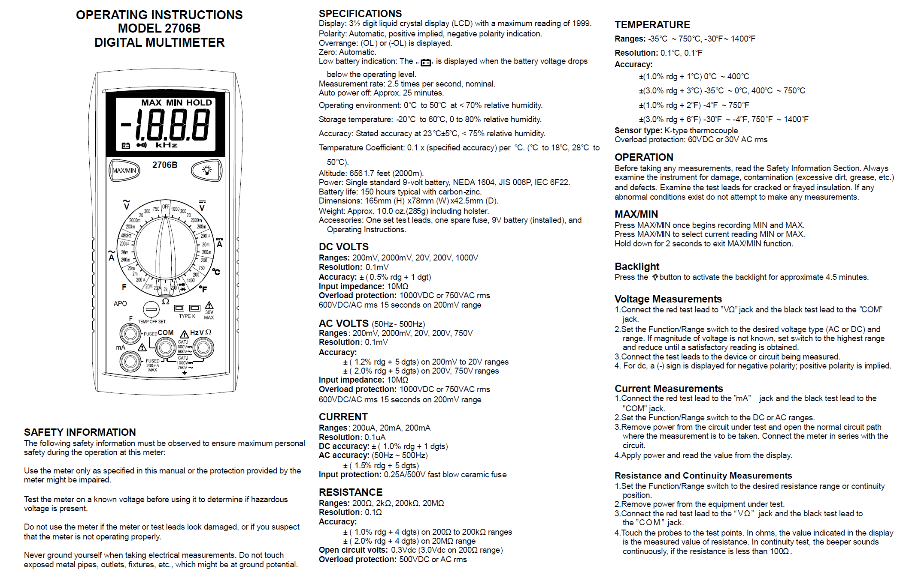
Lack of useful instructions/ Lack of Visual Content

Slide 20
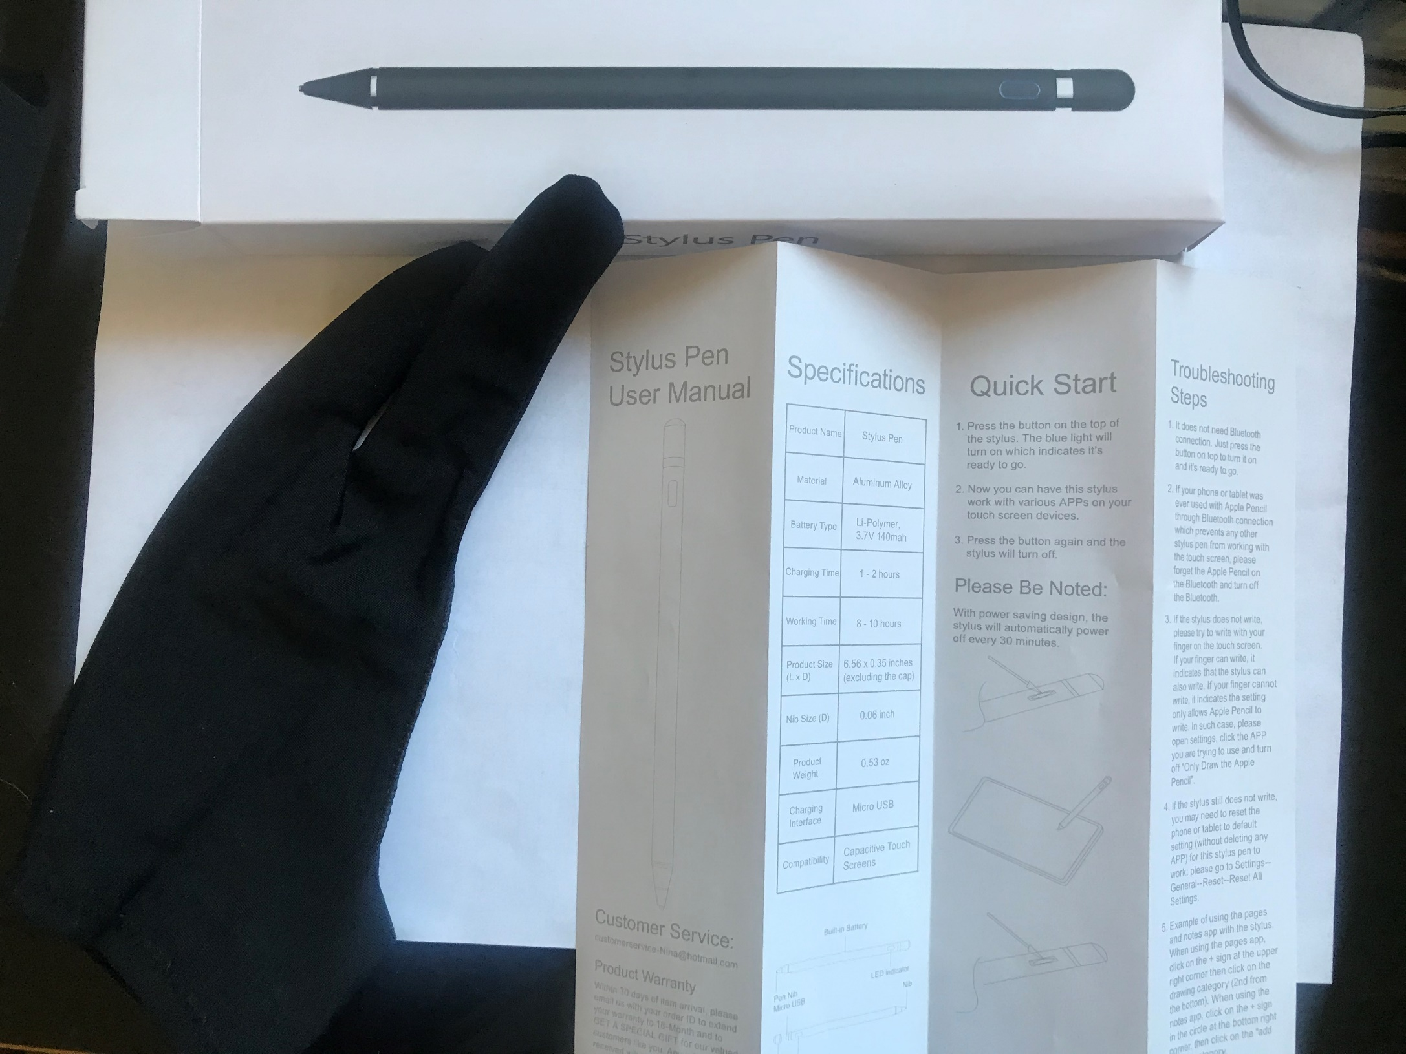

Slide 21
A documentation plan:
A documentation plan is a document containing all the necessary information for reference when working on a user manual, such as: general information about the project, tools used, timeframes, workflow details, etc.

Slide 22
Instructions:
Structure and clarity are key in instructions
Instructions must be action-oriented and minimalist.
Instructions that follow a particular structure.

Slide 23
Instructions:
The structure must:
Facilitate the correct actions
Enable users to work independently and at their own pace, and
Enable users to distinguish materials, tools and the general road map easily.

Slide 24

Instructions’ Structure:
Guide/Topic: All components of the instruction are in harmony and well-oriented and all topics are included
[Avoid Bad Navigation]
Instruction: A guide consists of several instructions designed to bring a task from its initial state to its desired state.
Step: Steps are the detailed descriptions within instructions

Slide 25
Each step must have a clear visual supported by a clear, task-centered sentence.
Use active present verbs: Open, Press, Connect…
“Fill the bottle” is way better than “You have to fill the bottle”.
Avoid long wordy sentences
Break down tasks into two or more sub-tasks when the user needs to perform several actions.
A maximum of 10-12 steps is recommended for your instructions to be effective.

Slide 26
Errors can have catastrophic consequences on the factory floor.
Instructional design theory teaches us that the best place to prevent (and correct) errors is within the work instructions.

Slide 27
1. Warning:
Alert operators to potential safety hazards and error-prone tasks. Use analytics to help identify problem areas in your manufacturing workflows.
2. Tip:
Provide a more detailed description with extra information on how to perform the step.

Slide 28
3. Alternative route:
An alternative way to perform the same task with the same result.
4. Fixes:
Errors happen. When they do, it’s essential that they are corrected quickly and effectively. Fixes direct users to the easiest potential solution for a likely error.

Slide 29
Structure your work instructions in a clear, step-by-step instruction hierarchy
Guide - topic - instruction - step.
Use an active tone of voice.
Keep it short and to the point.
Use a clear visual to illustrate the step.
Split up a task in several different sub-tasks (Separation between tasks)
Separate all additional information in icons (warnings - tips - alternative routes - error fixes).

Slide 30
Key Items in a User Manual
Introduction / Product overview
Key features
Installation (if needed)
Tell the reader about the expected results of each step
How to use…
Function of each feature, relationship between them…
Troubleshooting
Warnings and recommendations
Repeating the words such as not and never is good
practice in warnings
Customer service Information/ Website / How to contact

Slide 31
What is in the Box
YES | NO
SHUB® | • 1 x SHUB®
Four removable modules with connectors | 4 x removable modules with connectors
• 5 V DC, 4 A adapter | 1 × 5V DC, 4A adapter
Instruction manual | • 1 x Instruction manual

Slide 32
Address the reader directly
Say what your product or service does, not what it is designed to do
Avoid should (Do not put doubt in your reader’s mind.)
To launch the KwikTrans application, click the KwikTrans icon on the desktop. This should display the KwikTrans startup window, where you should be able to see a list of choices regarding.
Instead tell readers exactly what will happen next, using the present tense
The KwikTrans startup window is displayed, and shows a list of choices regarding.

Slide 33
Be careful using words like usually, normally and generally
Make it clear to the reader whether he / she has to do something or whether the system does something automatically
Be concise
Use verbs rather than nouns
This allows you to transfer the money vs. This allows the transfer of the money to be performed
Use adjectives rather than nouns
X is more homogeneous than Y vs. X has a higher homogeneity with respect to Y.
Use verbs rather than adjectives that end in –able
Download the key from our website. Vs. The key is downloadable from our website.

Slide 34
Limit yourself to one idea per sentence
Avoid long sentences
Avoid parenthetical phrases
Key rules for word order
Put the most important information at the beginning of the sentence.
English word order is strict: 1) subject 2) verb 3) direct object 4) indirect object
All these four elements should go as close as possible to each other.
Adjectives go before nouns. >>> difficult questions
Past participles generally go after nouns. >>>> data reported
Most adverbs go immediately before main verb. >>> I always confuse...

Slide 35
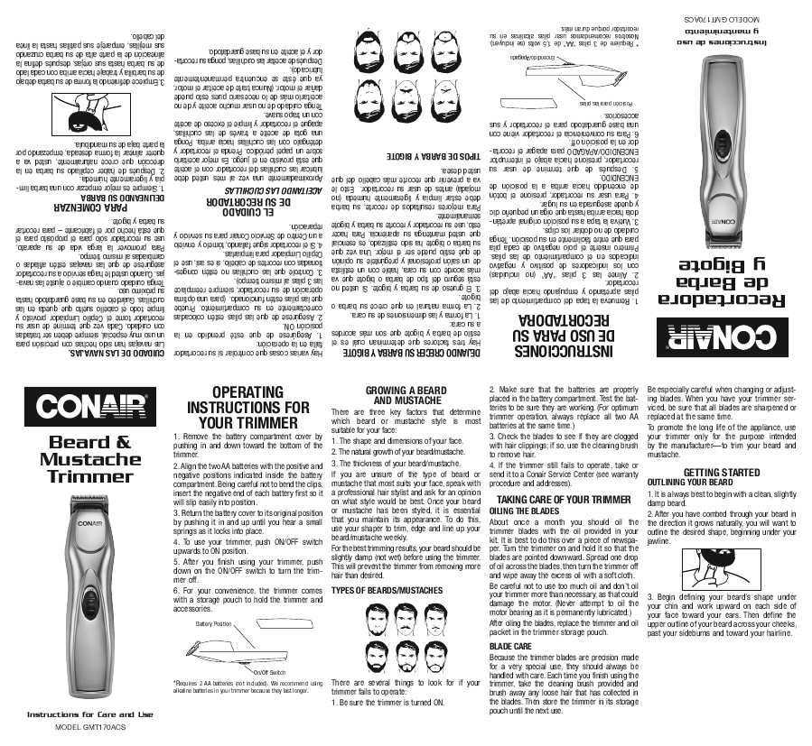
Bad

Slide 36
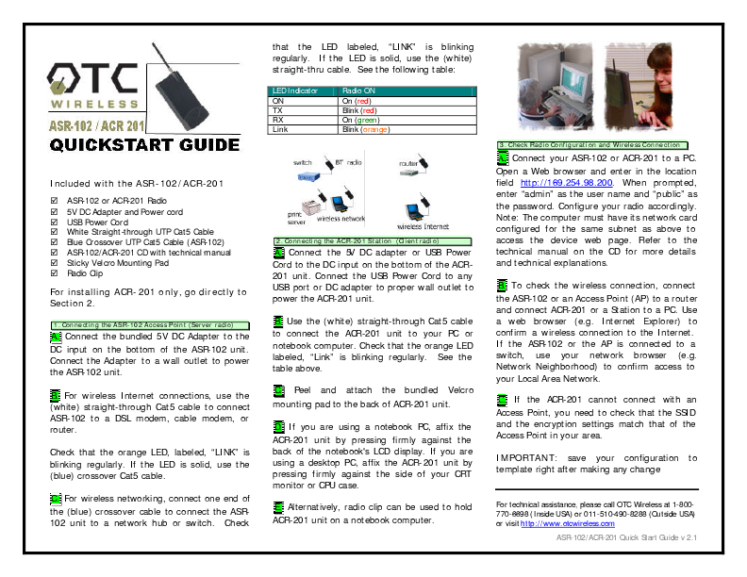
Bad

Slide 37
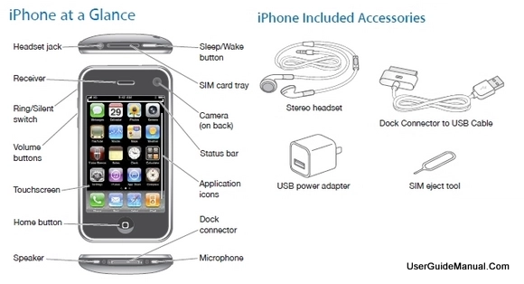
Good

